Slide 1


AI Powered Project Management: Accelerate Workflow

Slide 2
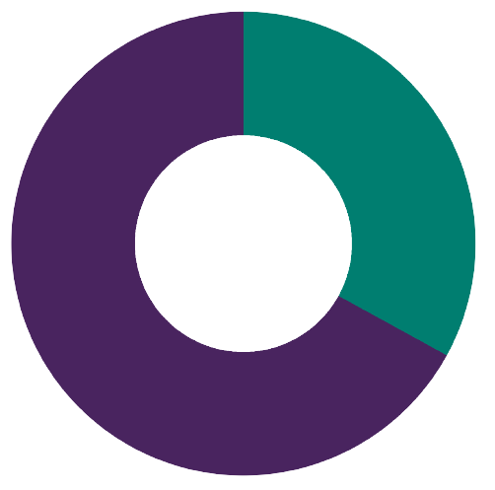


Problems with Project Management
Additional concerns:
Time spent in meetings/week (13 H)
33%
Productivity
Time spent on other tasks/week (27 H)
67%
(In most countries, out of 40 hours weekly)
Meetings over time
Mental Autopilot
Lack of stimuli
Hard to formulate summaries
Sources: Meeting Hours | Productivity

Slide 3
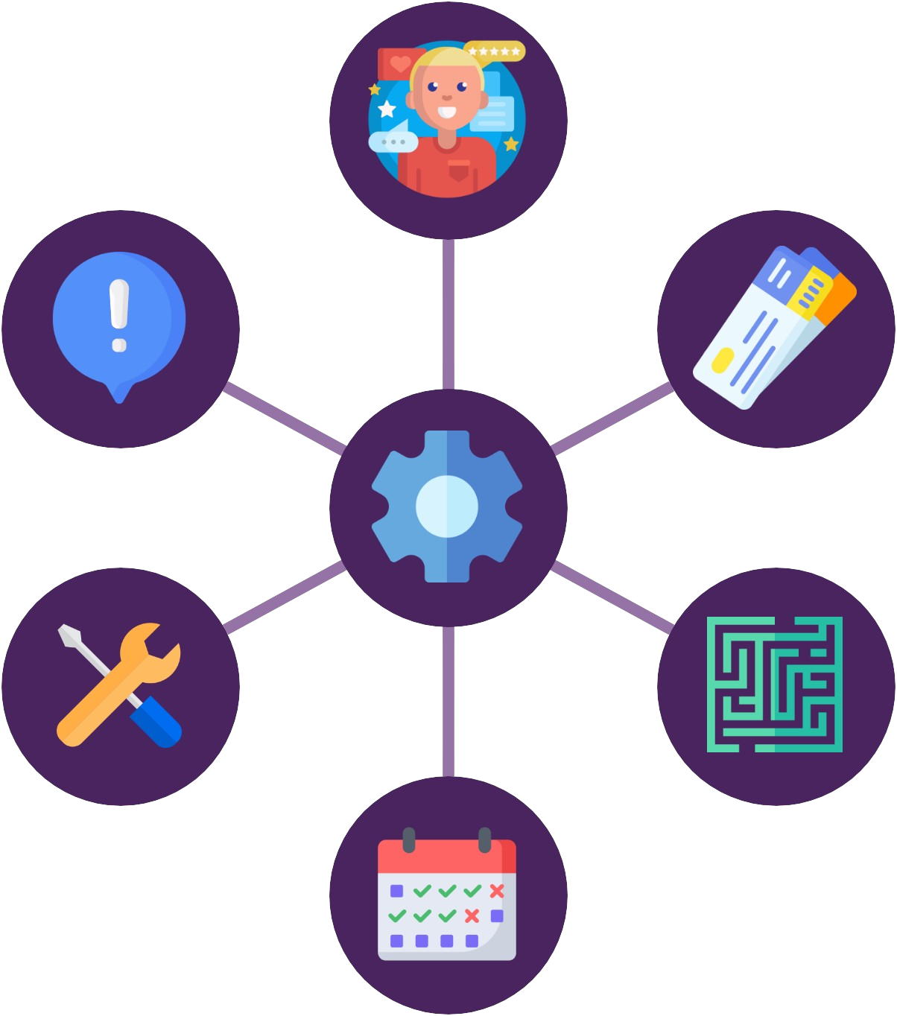
Product Vision
Summarize client requests
Estimate task complexity
Create and manage tickets
Provide support for clients
Keep track of information
Schedule tickets

Slide 4
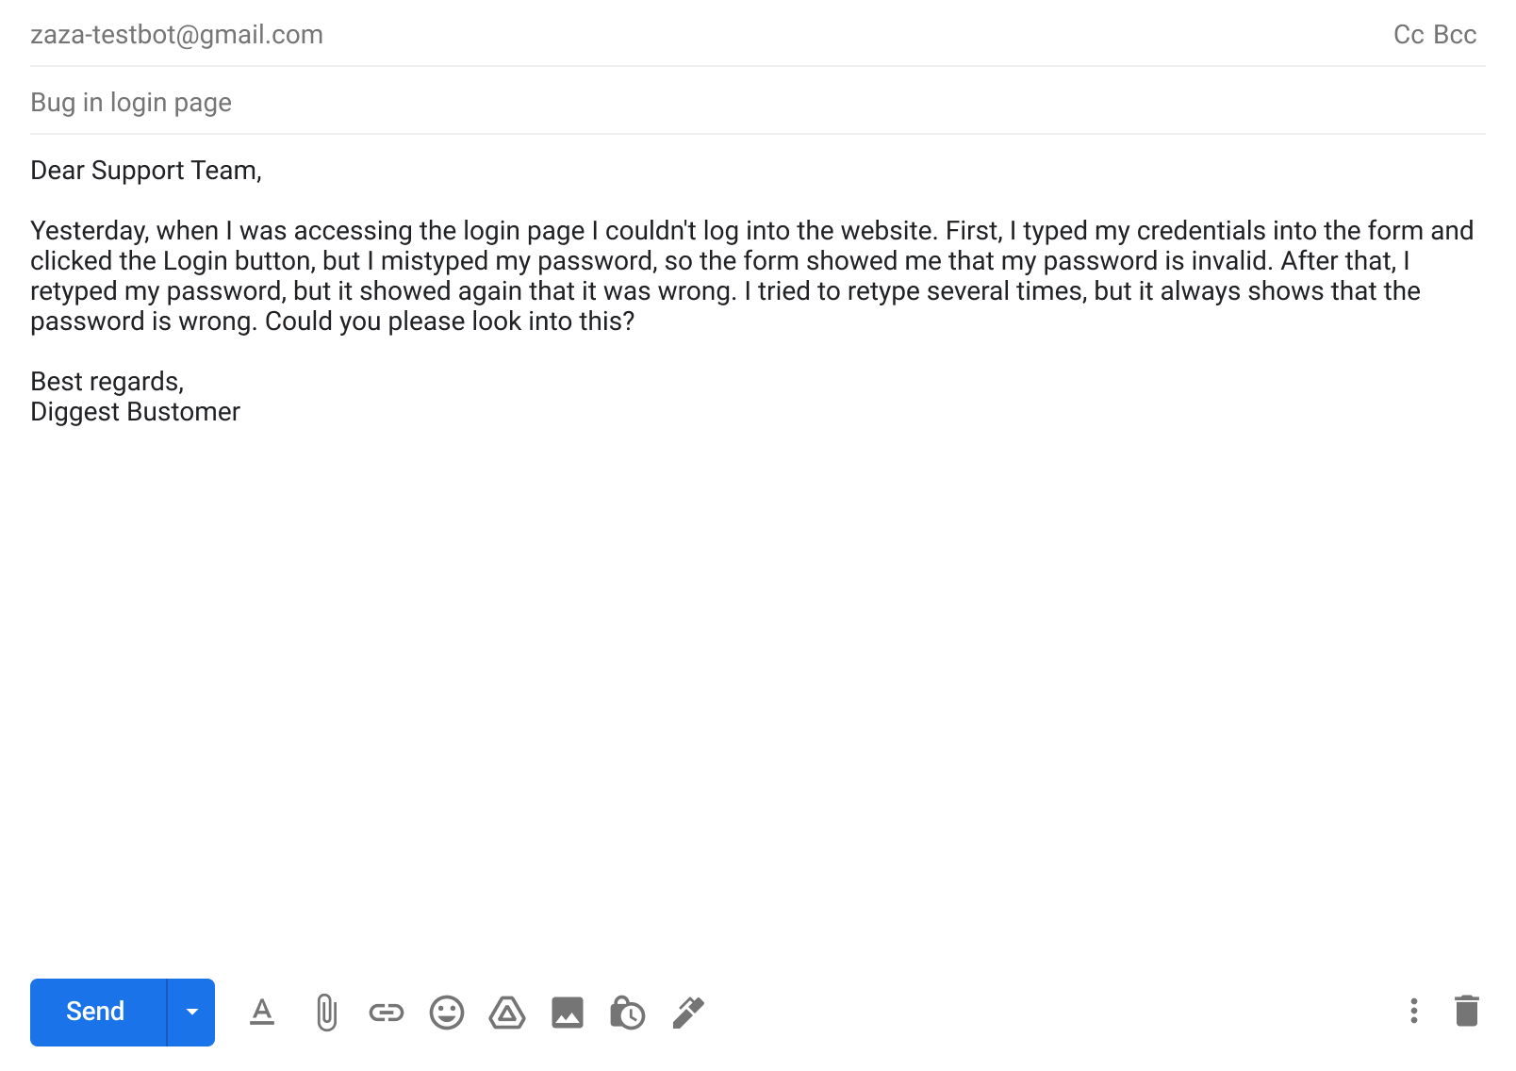
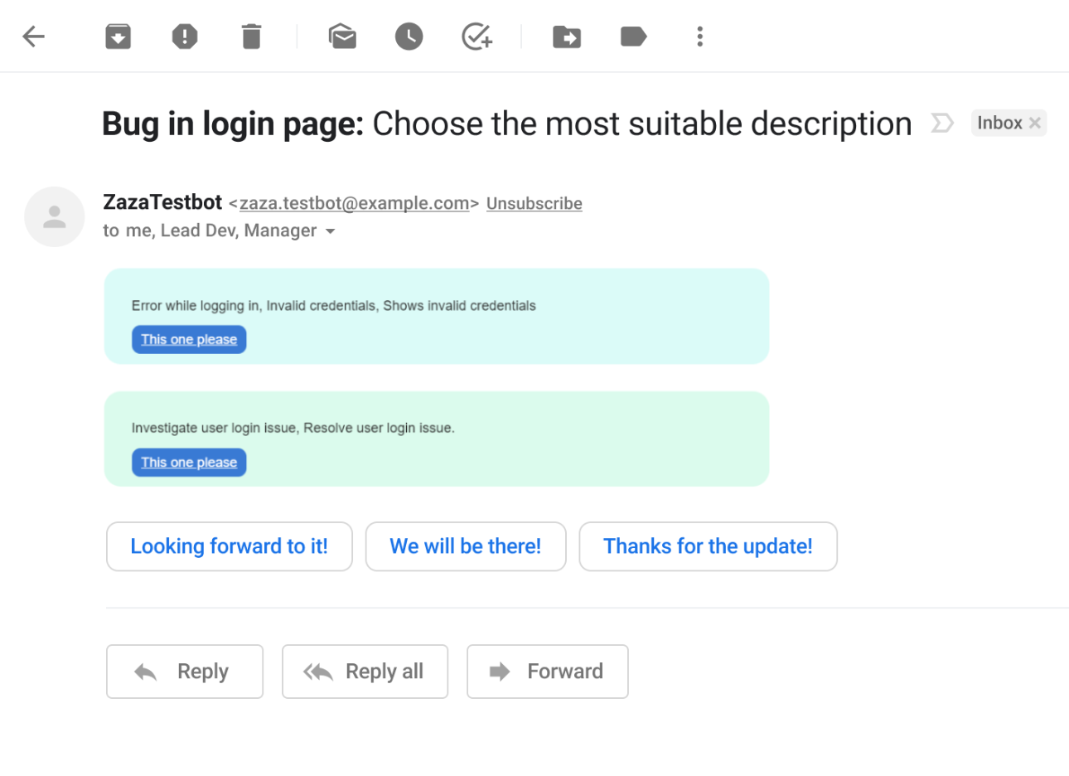
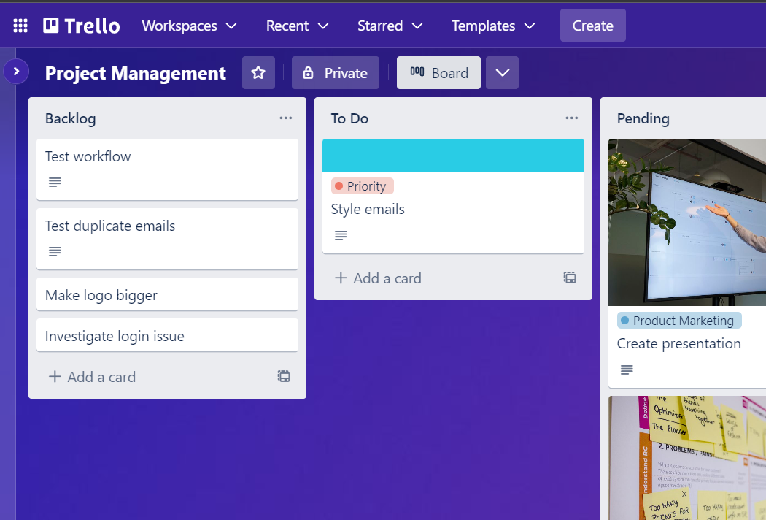
Product Demo
1. The client writes an email about an issue or feature request
2. Scrummy creates a summary and confirms the summary with the client.
3. After confirmation, a new ticket is created in the project management application

Slide 5
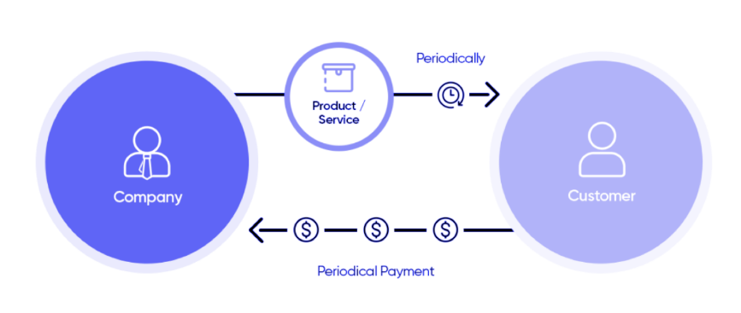
Business Model
Subscription-Based Business Model
150.000* Potential SME in Europe x 100€ monthly fee = 1.5M € MRR
with potential addressable market of 1.5M SMEs
Source: Statista, 1.5M SME in Europe. We considered the best case scenario as 1%.

Slide 6
SWOT
Strengths
Weaknesses
Efficient automated ticket creation
Improved ticket descriptions
Better project management - identifying blockers, calculate time estimation and capacity
Delivering high quality products quickly
Helping developers working more efficiently
Competitors may offer similar or better features.
New project management tools may arise with enhanced automation and accuracy features.
Changes in the Agile development industry may decrease the demand for such tools.
Opportunities
Threats
Not suitable for all organizations or projects
May require a learning curve for some users
Additional customization for specific needs
Collaborate with other project management tools
Develop mobile application for on-the-go accessibility
Broaden the intended audience beyond Agile development.

Slide 7



User stories
As a Scrum master I want to save time by automating the ticket creation process, so that I can focus on other important tasks.
As a project manager, I want to identify blockers and calculate time estimation and capacity.
As a developer I want to have more accurate ticket descriptions. With
this I can work more efficiently and deliver high-quality product.

Slide 8



Competitors
Eightfold
Specializes in talent acquisition
Help employees build their career profile
Build diverse, equitable workforce
Movework
Automate IT support
Automate other business workflows
Automate finance and facilities management
Frame.AI
Analyzes customer feedback
Creates insights based on tickets
Creates insights based on surveys and social media

Slide 9






Our Team
AI Master students from Hungary
Zsolt Csibi
Imre Molnár
Máté Borsy
Tamás Takács
Web Development
Machine Learning Operations
Commercial Manager
AI Development
Testing & QA
Prompt Engineering
Market Share
Data Analysis
Database
CI/CD
Marketing
Modelling
Building
Ethical AI

